Slide 1
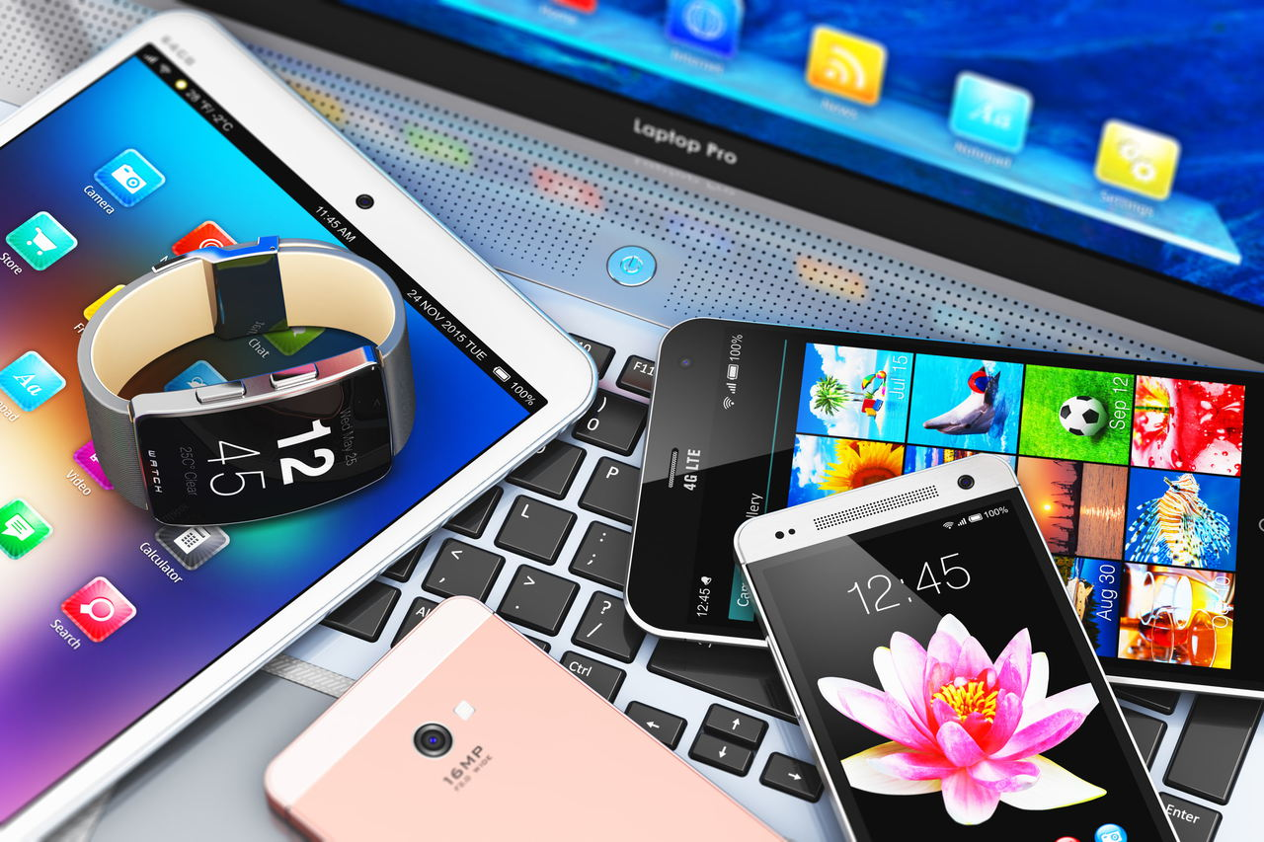
Digital device
BY/Eissa Mohamed & Hamza Mohamed

Slide 2
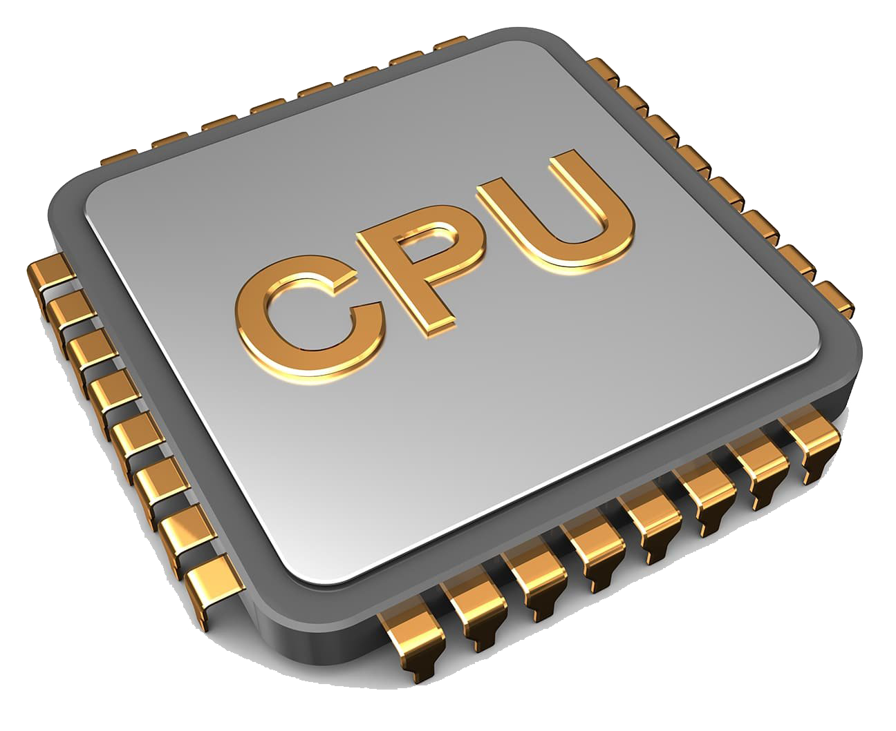
Processor
What Does Processor Mean?
A processor is an integrated electronic circuit that performs the calculations that run a computer. A processor performs arithmetical, logical, input/output (I/O) and other basic instructions that are passed from an operating system (OS). Most other processes are dependent on the operations of a processor.

Slide 3
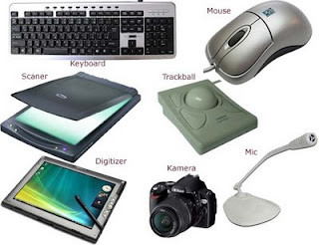
Input device
An input device is any hardware device that sends data to a computer, allowing you to interact with and control it. The picture shows a Logitech trackball mouse, an example of an input device.
The keyboard and mouse are a computer's most commonly used or primary input devices. However, other devices also input data into a computer.
Types of input devices.
What are the input devices of my computer?
What does an input device send to a computer?
Why does a computer need an input device?
Input devices for physically challenged users.
Related information.

Slide 4
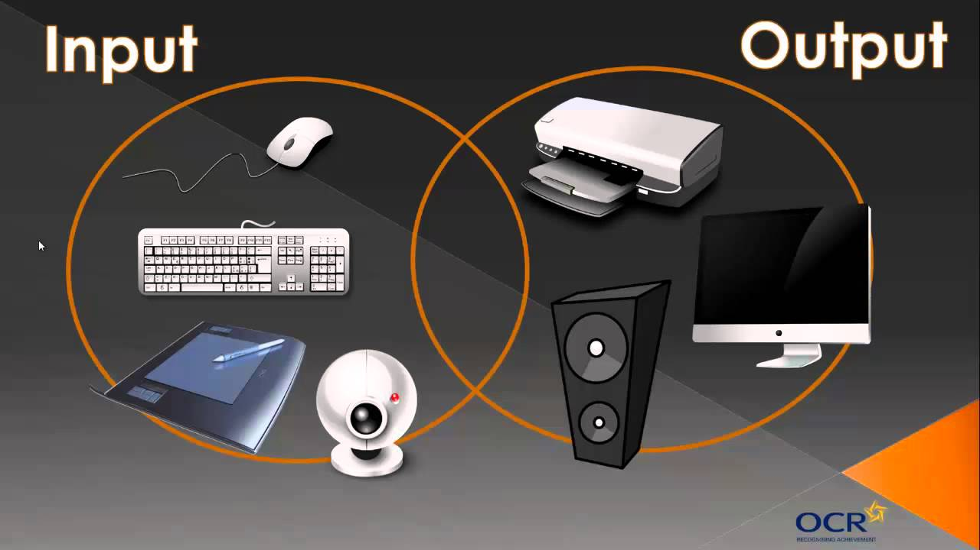
Output device
What Does Output Device Mean?
An output device is any hardware device used to send data from a computer to another device or user.

Slide 5
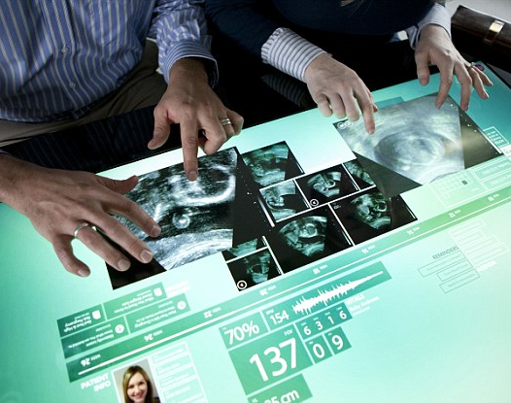
Touchscreen
A touchscreen or touch screen is the assembly of both an input ('touch panel') and output ('display') device. The touch panel is normally layered on the top of an electronic visual display of an electronic device.

Slide 6

Hand-held
A handheld personal computer (PC) is a pocket-sized computer typically built around a clamshell form factor and is significantly smaller than any standard laptop computer, but based on the same principles. It is sometimes referred to as a palmtop computer, not to be confused with Palmtop PC which was a name used mainly by Hewlett-Packard.

Slide 7
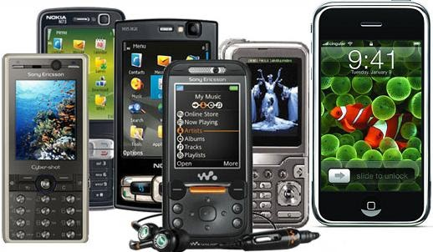
Mobile device
What Does Mobile Device Mean?
A mobile device is a handheld tablet or other device that is made for portability, and is therefore both compact and lightweight. New data storage, processing and display technologies have allowed these small devices to do nearly anything that had previously been traditionally done with larger personal computers.

Slide 8
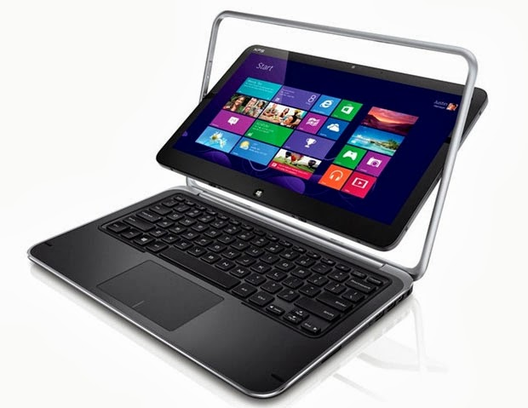
Tablet computer
What Does Mobile Device Mean?
A mobile device is a handheld tablet or other device that is made for portability, and is therefore both compact and lightweight. New data storage, processing and display technologies have allowed these small devices to do nearly anything that had previously been traditionally done with larger personal computers.

Slide 9
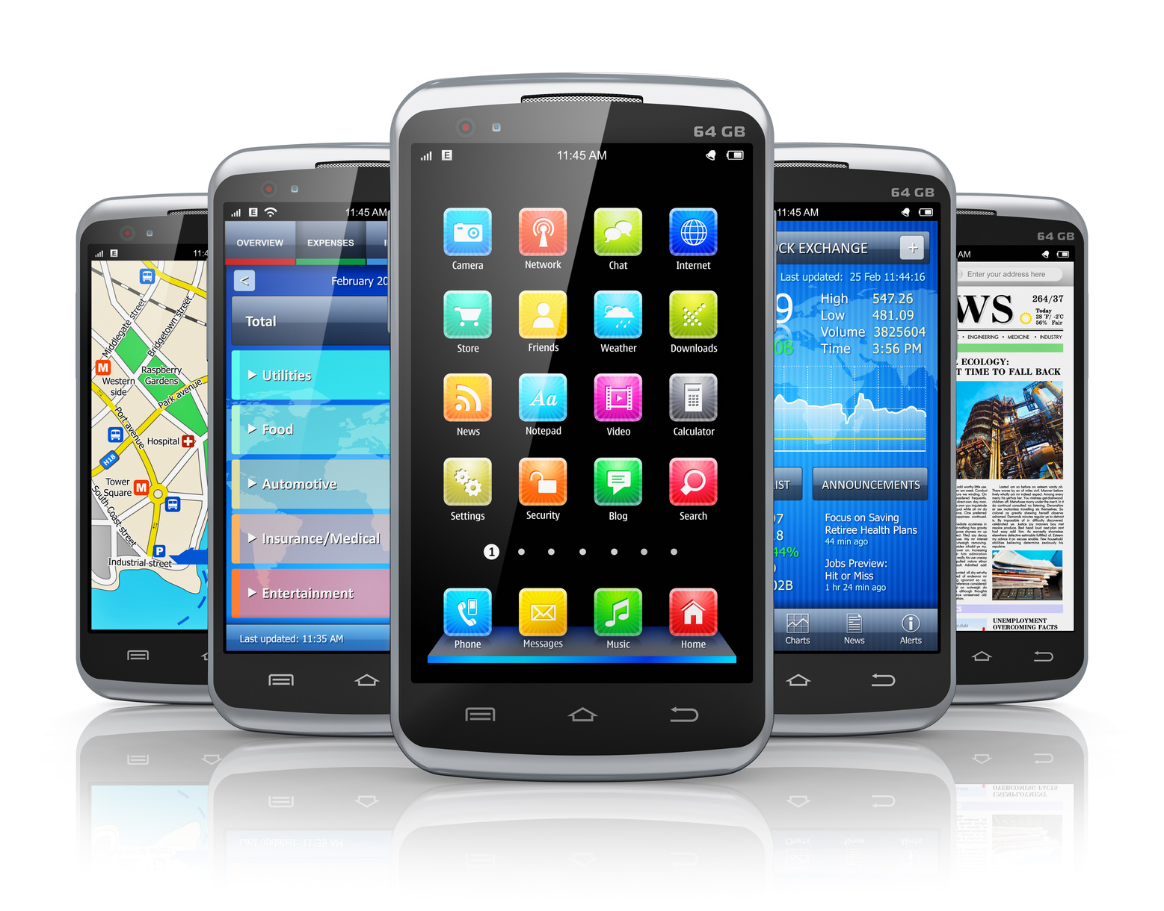
Smartphone
A smartphone is a portable computer device that combines mobile telephone functions and personal computing functions into one unit. They are distinguished from older-design feature phones by their more advanced hardware capabilities and extensive mobile operating systems, which facilitate wider software, access to the internet (including web browsing over mobile broadband), and multimedia functionality (including music, video, cameras, and gaming), alongside core phone functions such as voice calls and text messaging.

