Slide 1
How to use and store your files
by; Adam , hakim , and seif

Slide 2
Haw to store a file
If you are working in an application such as word processer ,there are to ways to save a file . You can use the file menu or click the save icon . If your file already has a name it will be saves by the same name . If it is new enter a name for it before you can save the file.

Slide 3


Slide 4
how to copy a file
You can reduce the risk of losing important by making a COPY OF THE FILE. It is called a back up file right click and press save

Slide 6
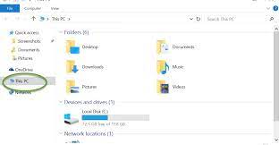
How to find a file
the file explorer gives information to help you find a file.
This is the file explorer

Slide 7
Using folders
Files help you to organize your work. They make the files easy to find. You could set up files for all kinds of your stuff. Like the ppts in a file, our homework in a file , the word in a file.

Slide 8
How to create a file
In file explorer, create new file by following these steps. 1 GO TO the area where you want to ad a file 2 right click using your mouse 3select new from the menu that appears , then click folder 4enter a name for the new folder

Slide 9


