Slide 1





Science Enquiry
Investigation

Slide 2



Asking Questions
Looking for Clues
Finding out Answers
PART ONE
PART TWO
PART THREE

Slide 3
What is an Investigation ?
When you try to find out more about something by exploring and gathering information , it can be about a mystery or a problem.

Slide 4

Ask a question
Why did my Toys disappear?!

Slide 5
Do some research
Look around your room and see where you played with them

Slide 6


Slide 7
Make a hypothesis
is to make a prediction

Slide 8
Test the hypothesis
See if it’s right or wrong
Search in your toy box , maybe under the bed and also in your closet

Slide 9
Collect the data
Toy box | The closet | Under the bed
Found Nothing | Found Nothing | Found my toys

Slide 10
Result
Did I found them in my toy box ? NO
Did I found them in the closet ? NO
Did I found them uner the bed ? YES

Slide 11
Conclusion
The last part of the searching process
.........................................................................................................
* I think my toys like to hide under the bed , maybe they can talk and
walk like us !

Slide 12
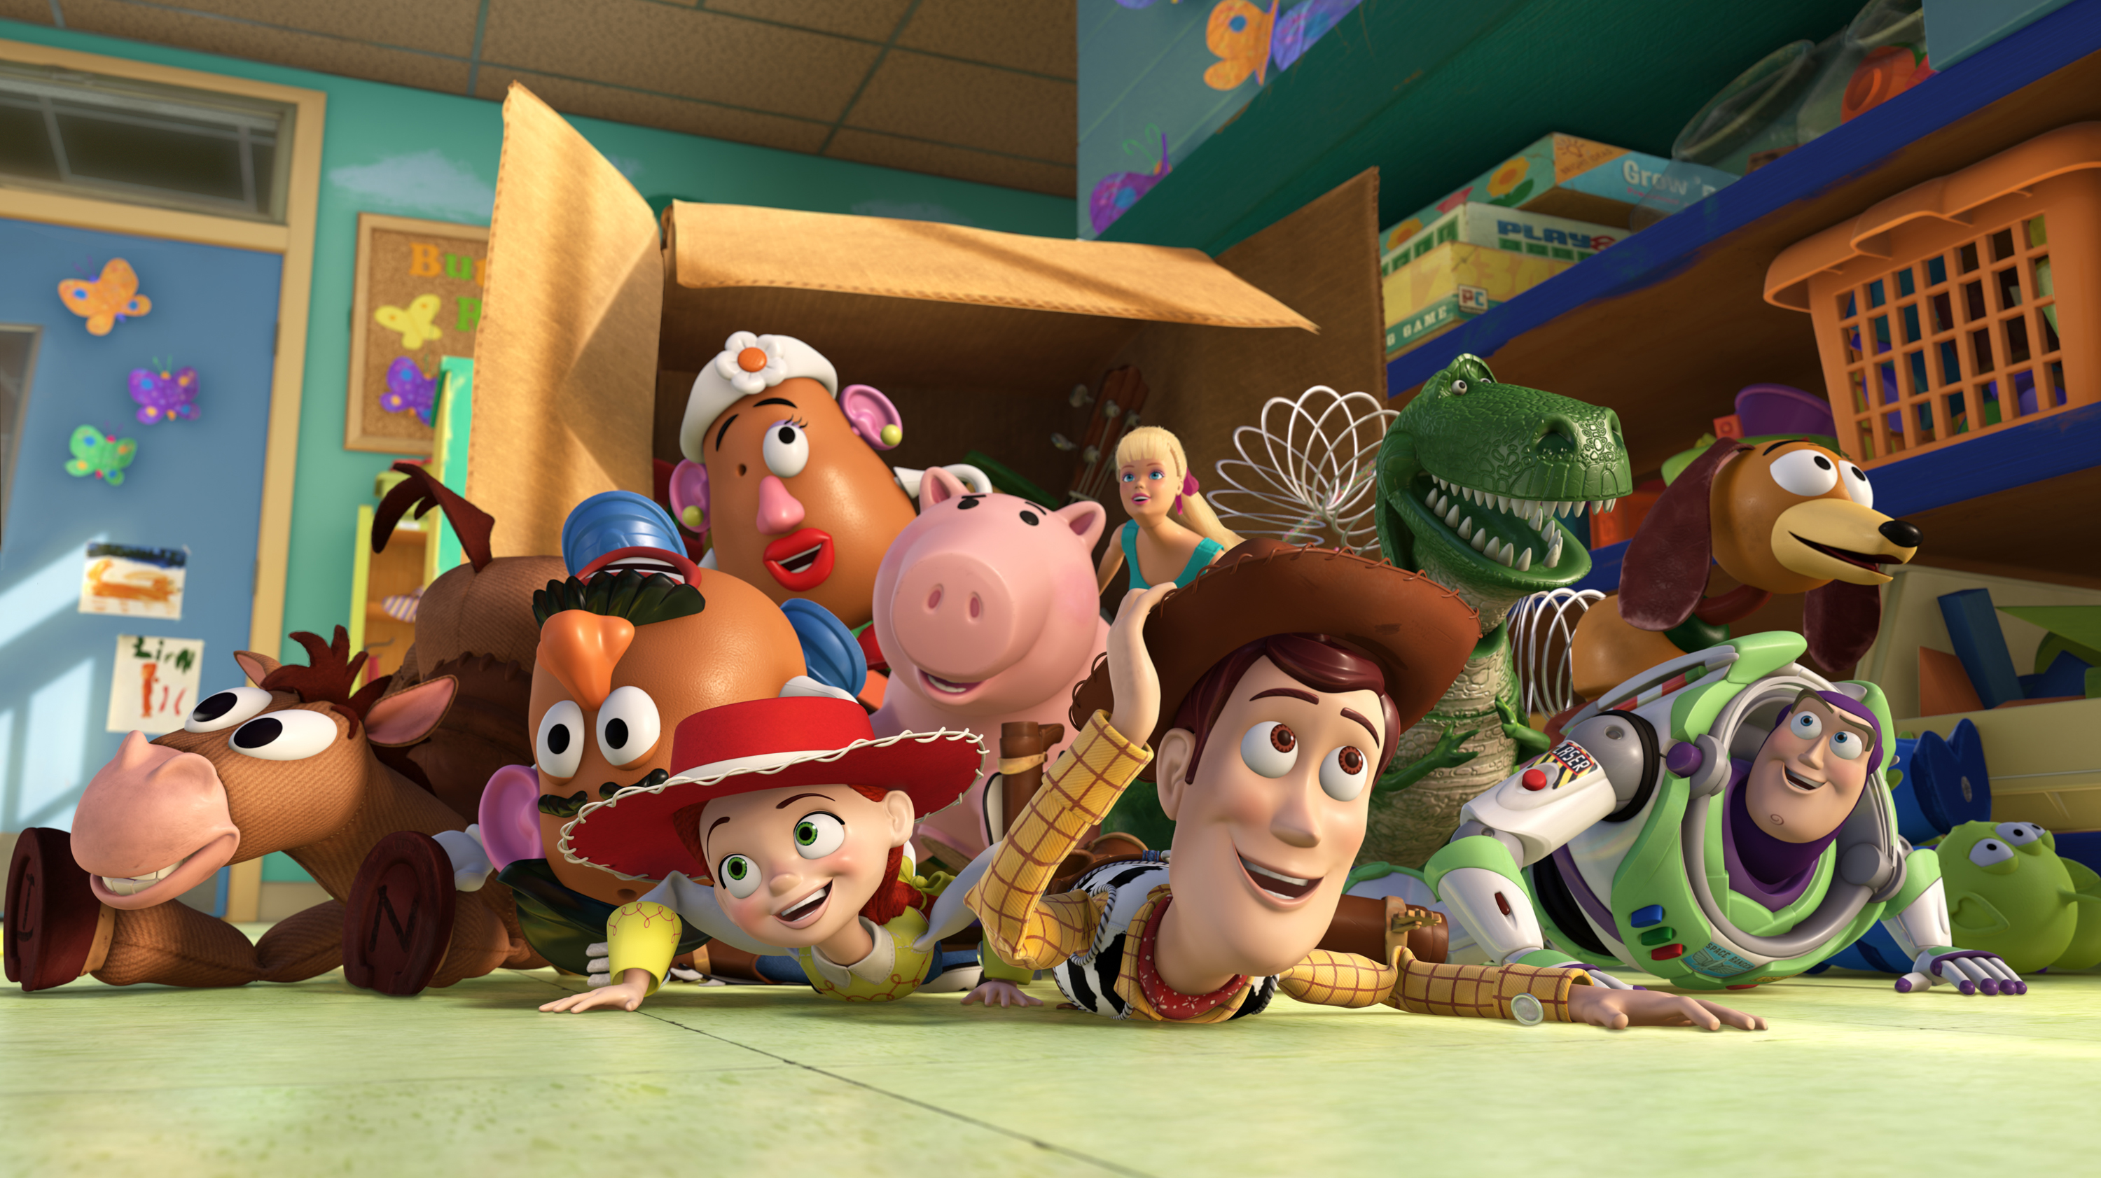

Slide 13
THANK YOU

