Slide 1
World War 2
year 4
By:Amman Shaaban

Slide 2
Daily Life

Slide 3
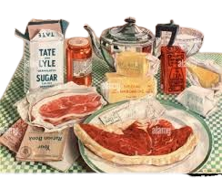
What did people eat
Previous
Next
During World War II, food was rationed, so people relied on essential and creative substitutes. Here’s a list of some common foods eaten:
- Meats: Canned meats like Spam, corned beef, and dried sausage.
- Grains: Wartime bread (often made with potato flour), rice, oats, and barley.
- Vegetables: Potatoes, carrots, cabbage, onions, and turnips.
- Fats: Margarine, lard, and vegetable oils (butter was scarce).
- Dairy: Powdered milk, condensed milk, and rationed cheese.
- Sweeteners: Honey, molasses, and artificial sweeteners (sugar was heavily limited).
- Preserved Foods: Pickled vegetables, dried fruits, and canned soups.
- Substitutes & Mock Foods: Egg powder instead of fresh eggs, mock fish fillets made from rice, and coffee substitutes like roasted barley.

Slide 4
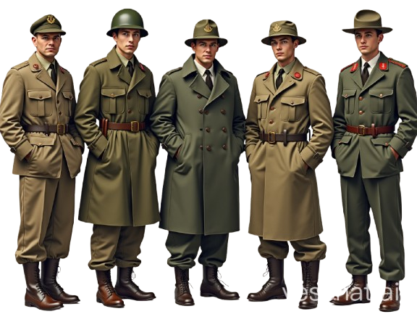
what kind of clothes did they wear
They weared Military Clothing
- Uniforms: Olive drab wool uniforms (U.S.), khaki cotton uniforms, and battle dress.
- Outerwear: Trench coats, greatcoats, and Eisenhower jackets.
- Headgear: Helmets (e.g., M1 helmet), berets, and peaked caps.
- Footwear: Combat boots, jump boots, and gaiters.
Civilian Clothing
- Utility Clothing: Simple, functional garments designed to conserve fabric.
- Women’s Wear: Dresses with shorter hemlines, tailored suits, and headscarves.
- Men’s Wear: Trousers, shirts, and jackets made from durable materials.

Slide 5
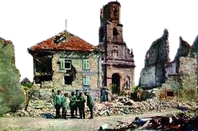
what did their homes look like
During World War II, homes looked quite different depending on the country and the circumstances. In war-torn areas, many homes were damaged or destroyed due to bombings and battles. Families often had to evacuate or live in makeshift shelters. In places like Britain, people built air raid shelters in their backyards or used underground spaces to protect themselves from bombings.
On the home front in countries like the United States, homes were affected by rationing—families had to limit their use of food, gas, and other supplies. Many households had victory gardens, where they grew their own food to support the war effort. Factories were repurposed for military production, and some homes were near newly built industrial centers.

Slide 6
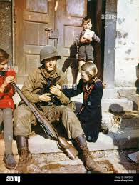
How did they spend their free time
Popular Leisure Activities:
-📻 Listening to the radio,News, music, and comedy programs provided entertainment.
-🎞 Watching films – Hollywood and British war films were a popular escape.
- 💃 Dancing and concerts – Social dances and live performances kept spirits high.
- ⚽ Sports and games – Soccer, basketball, and traditional children's games were enjoyed.
- 📚 Reading and writing – People wrote letters, read books, and played card games.
- 🎭 Community events – Theatres and concerts were organized, even during air raids.

Slide 7
Jobs and work
Previous
Next

Slide 8
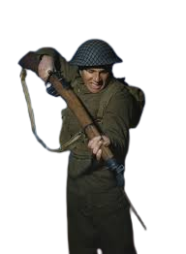
what kind of work did people do
Certainly! Here's a more structured list of jobs people worked during World War II:
1. Military Roles
- Soldiers
- Pilots
- Sailors
- Medics
- Engineers
2. Industrial Jobs
- Factory workers (producing weapons, vehicles, and supplies)
- Welders and machinists
- Riveters (many were women, famously known as "Rosie the Riveter")
3. Agricultural Work
- Farmers
- Land girls (women who worked in agriculture)

Slide 9
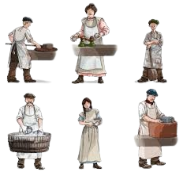
what were the jobs for children,woman and men
Children
- Evacuation and farm work
- Messengers and scrap collectors
Men
- Military service and factory work
- Farming and engineering
Women
- Factory jobs and nursing
- Intelligence work and farming

Slide 10
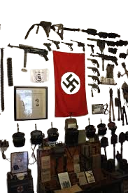
what machines or tools did they at work
Military
- Weapons: Rifles, machine guns, and artillery.
- Vehicles: Tanks, jeeps, and aircraft.
- Communication: Radios and code-breaking machines like the Enigma.
Factories
- Machine Tools: Lathes, milling machines, and grinders for producing weapons and vehicles.
- Assembly Line Equipment: Conveyors and presses for mass production.
Agriculture
- Tractors: For plowing and harvesting.
- Hand Tools: Hoes, sickles, and shovels.

Slide 11
How hard was it to find a job
Finding a job during World War II was actually much easier than before the war. The global conflict created an enormous demand for labor, especially in industries supporting the war effort. In the United States, for example, the country was still recovering from the Great Depression, with unemployment hovering around 25%. However, once the war began, factories were retooled to produce weapons, vehicles, and supplies, and unemployment dropped to around 10%.

Slide 12
family and relationship
Previous
Next

Slide 13
what was family life like
Family life during World War II was tough and constantly changing. Families faced separation as men went off to war, leaving women and children to manage households under rationing and shortages. Women stepped into new roles, working in factories, offices, and even military support positions, which reshaped traditional family structures. Children often had to grow up quickly, adjusting to fear, uncertainty, and, in some cases, evacuations for safety. Despite all of this, communities found strength in each other, contributing to the war effort in any way they could and holding onto hope for better days ahead.

Slide 14
how did family take care of eachothers
Families took care of each other during World War II in many ways, despite the hardships and separations caused by the war. With many men away fighting, women took on new responsibilities, working in factories, managing households, and supporting their communities. Families relied on rationing, carefully stretching food and supplies to ensure everyone had enough.
Children often had to grow up quickly, helping with household chores and contributing to the war effort in small ways. In some cases, extended families stepped in to provide care, with grandparents or neighbors looking after children while mothers worked. Communities also played a vital role, offering support networks and organizing childcare programs to help working mothers.

Slide 15
what role did children play in the family
children played a significant role in family life during World War II, often taking on responsibilities beyond their years. With many fathers away fighting and mothers working in factories or supporting the war effort, children had to step up in various ways.
Some helped with household chores, cared for younger siblings, and contributed to food production by working in gardens or farms. In many countries, children participated in rationing efforts, ensuring their families made the most of limited supplies. Others were involved in scrap collection, gathering metal, rubber, and other materials needed for military production.
In war-torn areas, children faced evacuations, being sent to safer locations away from bombings and battles. Some even became involved in resistance movements, secretly delivering messages or assisting in small ways. Their experiences shaped their resilience and maturity, often forcing them to grow up quickly.

Slide 16
what were relantionships like between diffrent social classes
During World War II, relationships between different social classes shifted in many ways. The war created a sense of unity, as people from all backgrounds had to work together for survival and victory. In places like Britain, the shared experience of rationing, bombings, and evacuations helped break down some class barriers, fostering a stronger sense of community.
However, social inequalities remained. Wealthier families often had better access to resources and safer living conditions, while working-class families bore the brunt of hardships. The evacuation of children from cities to rural areas also exposed stark differences in living standards, leading to calls for improved housing and sanitation.

Slide 17
School and Education
Previous
Next

Slide 18
Did children go to school
During World War II, children's education was heavily disrupted, but schools remained open in many areas. In Britain, for example, many schools in cities were closed due to bombings, and children were evacuated to rural areas, where they attended school in temporary locations like churches and village halls. Some schools operated on a double shift system, where local children attended in the morning and evacuees in the afternoon.
In Germany, education was influenced by Nazi ideology, with lessons focusing on military training and propaganda. In occupied countries, schooling was often restricted or controlled by the occupying forces. In Japan, children continued their education but also participated in war-related activities, such as factory work .

Slide 19
What subject did they learn about
During World War II, children's education was shaped by both necessity and propaganda. Here's a more refined breakdown of the subjects they studied across different countries:
- Core Subjects: Mathematics, reading, writing, and science remained fundamental, though sometimes altered to align with wartime priorities.
- History & Geography: Often tailored to support national ideology, emphasizing patriotic narratives or the strategic importance of various regions.
- Military & Survival Training: In countries like Germany and Japan, older students received lessons on military drills, first aid, and survival skills.
- Rationing & War Economics: Teaching children how to manage limited resources, understand wartime production, and contribute through conservation efforts.
- National Identity & Propaganda: Schools in authoritarian regimes incorporated political teachings to instill loyalty and nationalism.
- Physical Conditioning: Strength and endurance were prioritized to prepare youth for potential military service or wartime labor.
- Practical & Vocational Skills: Agriculture, craftsmanship, and domestic skills became essential for sustaining communities under strain.

Slide 20
How were schools diffrent from today
During World War II, schools faced immense challenges due to the war. Many were closed or repurposed for war efforts, such as sheltering evacuees or serving as temporary facilities for other purposes. In cities, students were often evacuated to rural areas, resulting in overcrowded schools. With male teachers conscripted into the armed forces, schools struggled with larger class sizes and fewer educators.
The curriculum was adjusted to reflect the wartime environment, emphasizing patriotism, resourcefulness, and community efforts. Students were actively involved in tasks like fundraising and collecting materials for the war effort. Resources like books and supplies became scarce, and construction of new facilities was halted.

Slide 21
who was alowed to go to school
During World War II, education faced significant disruptions worldwide. In many countries, schools were closed or repurposed for wartime efforts, such as housing evacuees or serving as military facilities. In Britain, for example, children from urban areas were evacuated to the countryside to escape bombings, which often meant their education was interrupted or conducted in makeshift classrooms.
In the United States, education adapted to support the war effort, with schools emphasizing subjects like mathematics and science to prepare students for roles in industries and the military. Many young male teachers were conscripted, leading to teacher shortages and larger class sizes.

Slide 22
Technology and Inventions
Previous
Next

Slide 23
what tools or machines or inventions were comman at the time
During World War II, innovation surged in response to the demands of the conflict. Tools and machines like radar transformed military strategy by enabling the detection of enemy movements, while vehicles like the Jeep proved invaluable for transportation in harsh conditions. Medical advancements, such as the mass production of penicillin, saved countless lives on the battlefield. The war also accelerated the development of early computers, which played crucial roles in tasks like codebreaking. These innovations not only shaped the outcome of the war but also paved the way for technological advancements that we continue to benefit from today

Slide 24
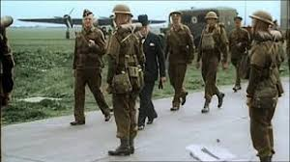
how did people travelle
During World War II, transportation was shaped by the demands of the conflict and resource shortages. Railways were heavily relied upon for moving troops, equipment, and supplies across long distances, while maritime convoys played a crucial role in transporting goods and soldiers across oceans. On land, motor vehicles like trucks and Jeeps were essential for mobility, especially in combat zones. Air travel also became increasingly significant, with aircraft used for troop deployment and supply drops. In some regions, traditional methods like pack animals were still used for navigating difficult terrains. The war effort transformed transportation systems, prioritizing efficiency and adaptability to meet the challenges of the time

Slide 25
what new discoveris or invention were changing the world
World War II was a catalyst for groundbreaking discoveries and inventions that reshaped the world. Radar technology revolutionized military strategy and later found applications in aviation and weather forecasting. Penicillin, the first widely-used antibiotic, saved countless lives and transformed medicine. The development of early computers, such as the Colossus, laid the foundation for modern computing. Synthetic rubber addressed wartime shortages and became essential for industries. The atomic bomb, though devastating, marked a turning point in global geopolitics and scientific research. These innovations not only influenced the war's outcome but also had lasting impacts on technology, healthcare, and society

Slide 26
Thank you
Previous
Next

Slide 27
THANKS!
Previous
Next
Do you have any questions?
remainder@freephone.com
+91 620 421 838
your website.com
Please, keep this slide for attribution

